Slide 1
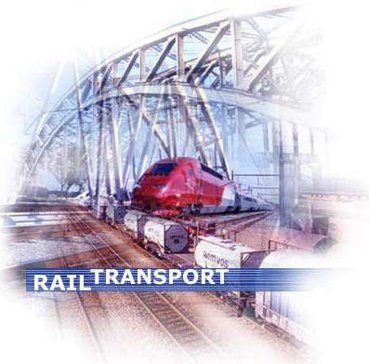
Intermodal Transport
BARGE

Slide 2
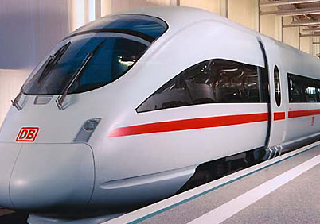
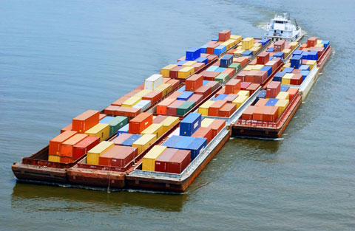
Topics
Rail
Inland navigation

Slide 3
Topics (rail freight transport)
statistics (volumes, ton-kilometers, market segments)
railway services
market organisation
policy measures railway transport
international railway connections

Slide 4
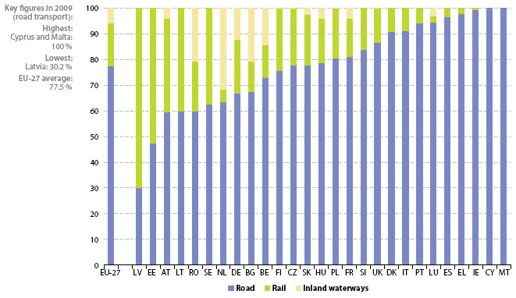
Modal-split of the EU 27 (2009)
Source:
Eurostat 2012

Slide 5
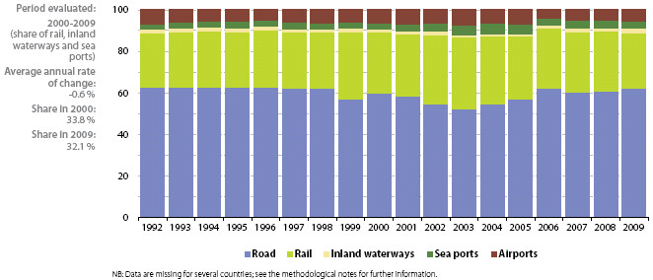
Investment in transport infrastructure per mode of transport (1992-2009)

Slide 6
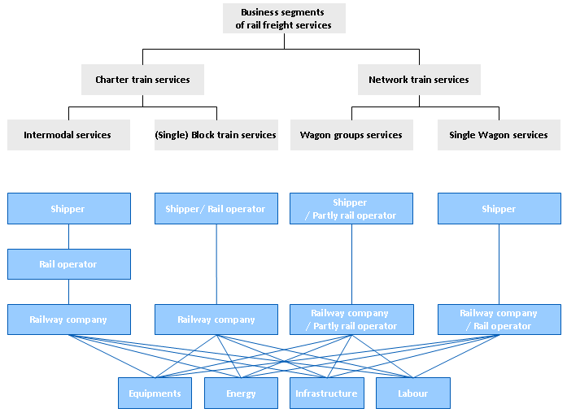
Business segments of Rail Freight Services

Slide 7
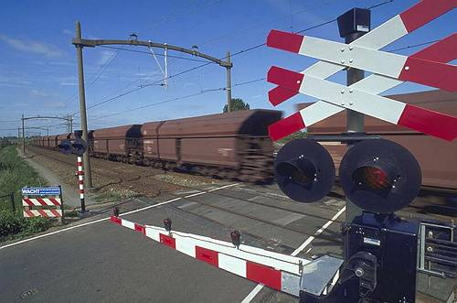
Market segments
Forestry & Agricultural goods
Chemical & mineral oil
Building materials & industrial goods
Ore, coal & steel

Slide 8
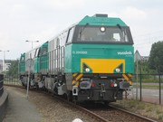
Market organisation
principals:
shippers, sea carriers, forwarders, rail operators
providers:
rail freight transport companies (DB Schenker, ERS, Captrain, Husa Transportation, SBB Cargo, HGK,
B-Cargo, SNCF-Fret etc……..)
slot allocation:
Prorail / Keyrail (Netherlands)
DB Netz (Germany)

Slide 9
Market threats rail transport within Europe
international barriers at the borders
(technical and operational)
priority to passenger traffic
High investments, guided transport and strong competition in the road transport and inland navigation sector, put a pressure on the tariffs of railway transportation
the single wagon concept copes with financial problems
General technology but also information technology is lagging behind.

Slide 10
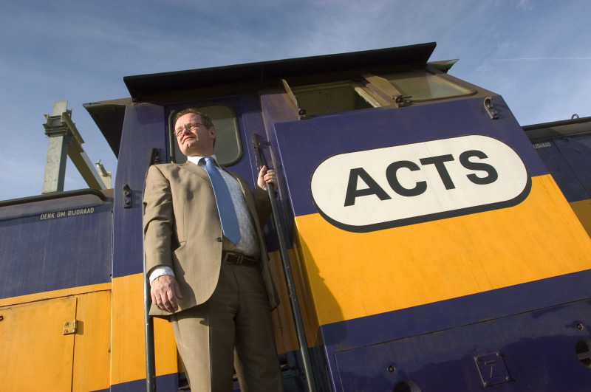
Social interest railway transport business (opportunities)
congestion road traffic
environmental issues
interest of rail freight transport for (inter)continental trade
restrictions on road transport (especially for transports via
the alps.

Slide 11
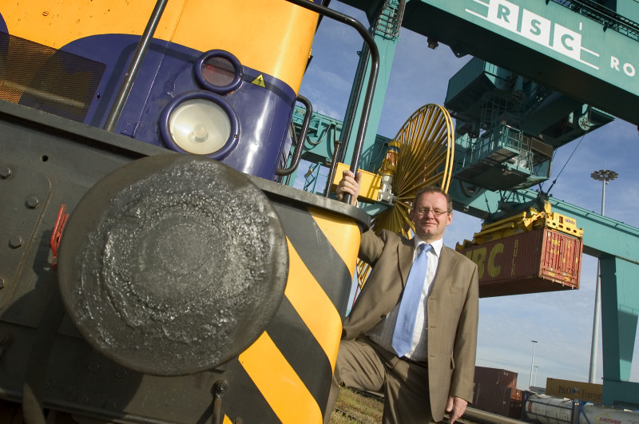
Measures/ developments rail transport
liberalisation and commercialisation of rail transport
(new private players);
development of an integrator role carried out by the railway companies;
development of information technology for the railway sector;
international operation and better cooperation between railway companies;
reorganisation of single wagon traffic;
development of intermodal rail shuttles;
Railtax (infrastructure charges);
chartering of logistical service providers.

Slide 12
Railway axis for freight transport between NL and D
Rotterdam
Utrecht
Kijfhoek
Arnhem
Betuweline
Emmerich
Northern-
Ruhrgebiet
Lage Zwaluwe
Nijmegen
Moerdijk
‘s Hertogenbosch
Roosendaal
Breda
Tilburg
Eindhoven
Venlo
Western-
Ruhrgebiet
Brabantlane
Iron Rhine
Sloe
Belgium
Roermond

Slide 13
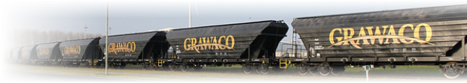
Conclusions, summary
Combined transport by rail and road is growing fast (containers);
Rail transport is an old fashion industry but due to the liberalisation (and so new private companies) developing fast.
Rail transport has its own market. Railway companies understand more and more that it is very difficult to compete with barge and road transport.

Slide 14
Subject inland waterways
figures inland waterways
characteristics
market organization
market structure: characteristics of the branch
tendency towards overcapacity and low profit margins

Slide 15
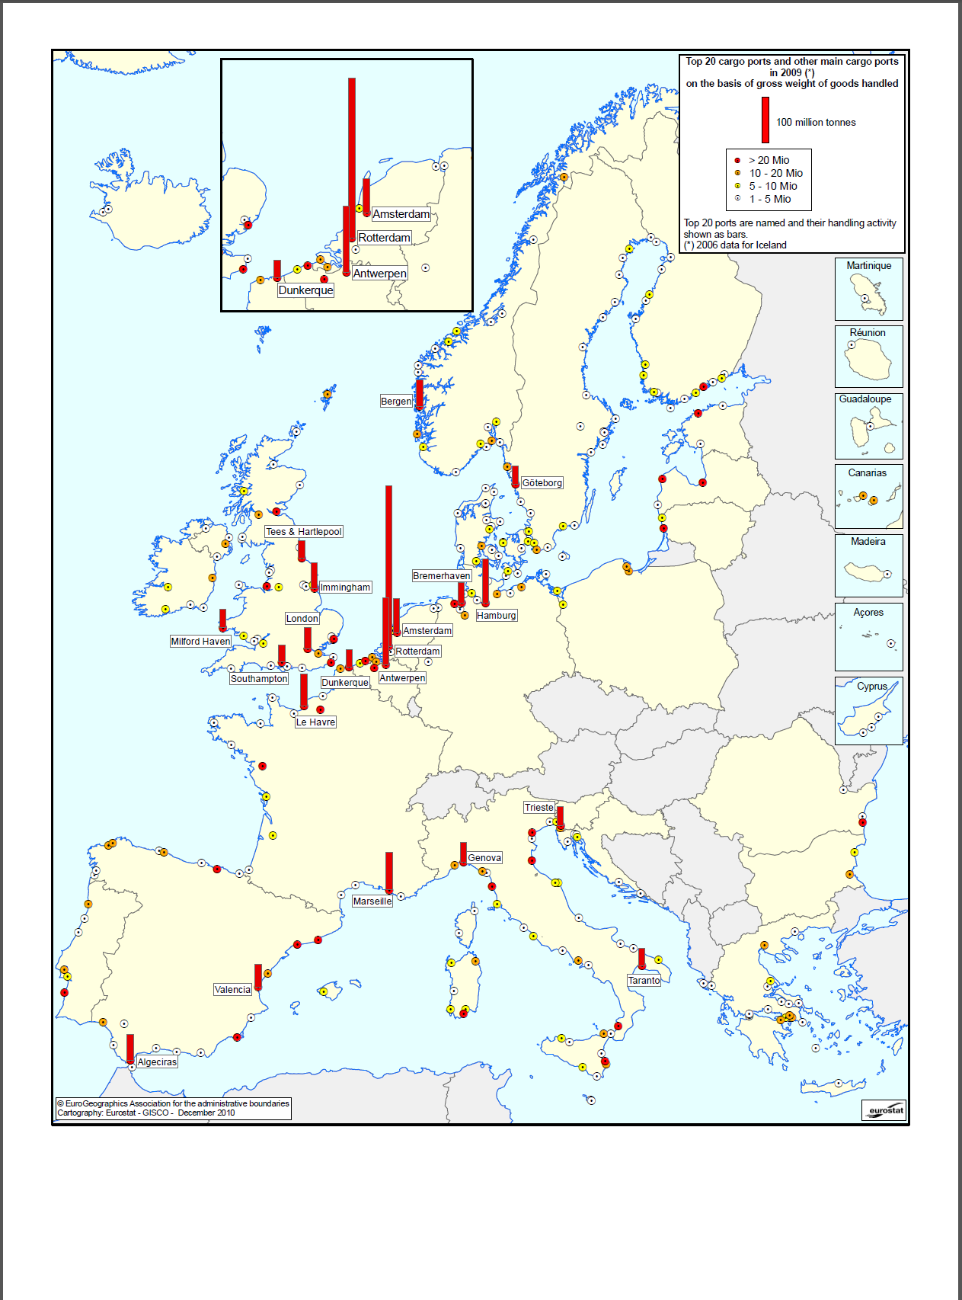
Eurostat dec 2010

Slide 16
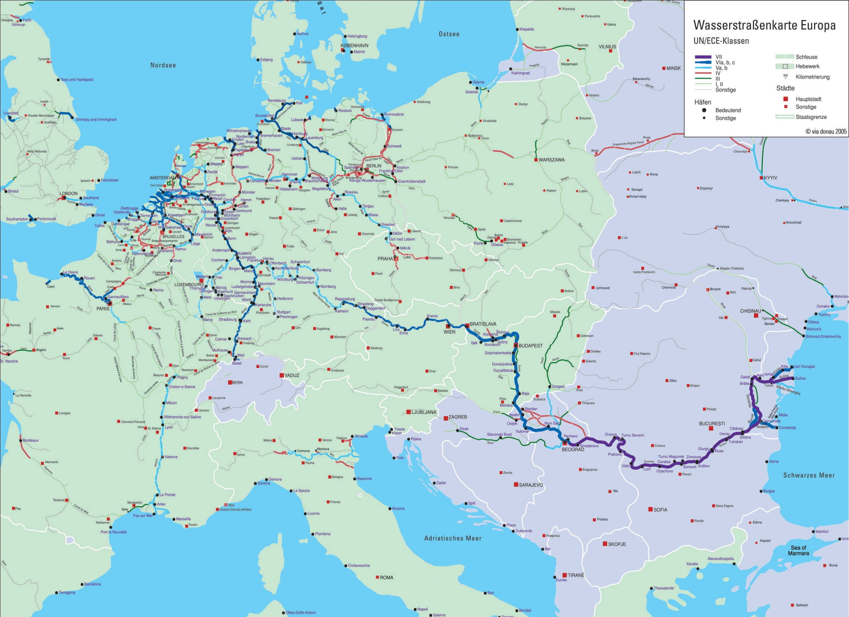

Slide 17
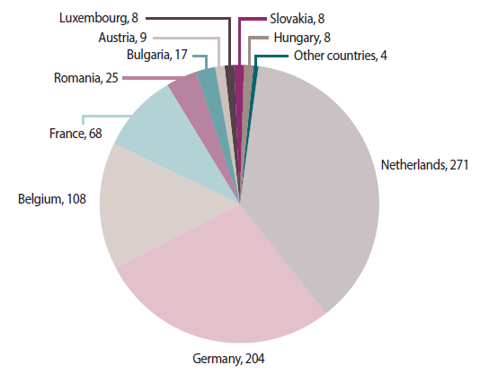
Freight transport by inland waterways
in 2009 in mio tons
 | 2004 | 2005 | 2006 | 2007 | 2008 | 2009
EU-27 |  |  |  | 521 | 509 | 421
Austria |  | 9 | 9 | 12 | 11 | 9
Belgium | 147 | 160 | 166 | 135 | 130 | 108
Bulgaria | 4 | 5 | 6 | 7 | 11 | 17
Croatia |  |  |  |  | 6 | 5
Czech Rep | 1 | 2 | 1 | 1 | 1 | 1
France | 67 | 68 | 71 | 76 | 73 | 68
Germany | 236 | 237 | 243 | 249 | 246 | 204
Hungary | 7 | 8 | 7 | 8 | 9 | 8
Luxembourg | 11 | 10 | 11 | 10 | 11 | 8
Netherlands | 319 | 318 | 318 | 353 | 345 | 271
Poland |  | 7 | 7 | 6 | 6 | 3
Romania |  | 33 | 29 | 29 | 30 | 25
Slovakia |  | 2 | 2 | 8 | 8 | 8
Eurostat 2012 – missing countries have no inland waterway transport

Slide 18
Characteristics inland waterway transportation
Inland waterway transport; a mode of transport for the middle
to long distance and large parcels.
Main products:
bulk cargo: coals; ore; grain; sand; gravel; cattle-fodder;
Containers
long lifecycle of the vessels (technically);
water conditions affect the capacity of the ships and influence the conduct of business

Slide 19
SWOT Inland waterways
Strengths: Weakness:
High safety level - Accessibility
economies of scale - market range
Low price per ton - Slow (on the long distance)
Low variable costs - High handling costs
Low external costs - not many destinations
environmental friendly
Opportunities: Threats:
Higher accessibility of small waterways - competition with other modes
High quality of the chain management of transport
New markets like: automotive, garbage -Convention of Mannheim
consuming goods. - higher frequency means
Shunting in a port is easy smaller parcels.

Slide 20
Market structure
Market 1: oligopsony
(limit of consumers)
small shipping companies
(papa & mama companies)
small ships
via freight brokers (forwarders) and larger shipping companies
Market: everything you can get!
market 2: oligopoly
(limit of suppliers)
Large shipping companies
modern push barges & container vessels
own office; direct contact with shippers (on contract basis)
Market: ore, coal, steel,
containers etc.

Slide 21
Tendencies towards overcapacity & low profit margins
water conditions/
economic climate/
non-transparency
of the market
Finance capital
policy
of the banks
continuing
of the business
Tendency towards
overcapacity
[+]
European policy:
“old for new”
(price policy)
/ liberalisation
dominant position of shippers and freight brokers (forwarders)
high fixed
costs
[+]
negative
supply curve
tariffs
low profit margins

